Slide 1

Predicting Patient Deterioration based on General Internal Medicine Dataset
Team 5.
2025 Toronto Health Datathon

Slide 2
Background
Patient deterioration leads to adverse events, longer hospital stays, and higher costs.
Traditional clinical assessments may miss complex patterns of deterioration.
Extracting meaningful insights from diverse features (e.g., demographics, lab results) is challenging.
Early identification of at-risk patients improves mortality outcomes.
Notes:
Some physicians had higher mortality rates, can we predict deterioration events in advance, 26% mortality reduction since deploying tool (Signal One bought model) -Amol Verma

Slide 3
Study Question
Hypothesis
What features are associated with or can be used to predict patient deterioration in the General Internal Medicine ward leading to death or ICU transfer?
We specifically hypothesized that those prescribed a combination of Cardiovascular medications such as hypotensive drugs, vasodilating drugs as well as central nervous system agents such as anticonvulsants would directly correspond to patient outcomes leading to death.

Slide 4
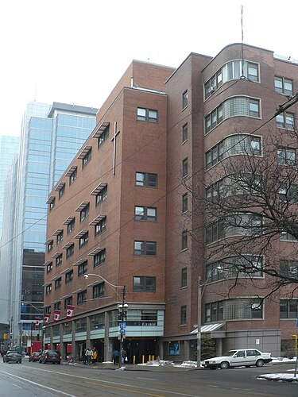
Dataset Information/Study Population
22,000+ patient encounters from 14,000 unique patients admitted to the GIM service at St. Michael’s Hospital between 2011 and 2019.
Patients with a minimum of 30 hours admission are included in the dataset.
De-identified health data: Vital Signs, Laboratory Measures, Shift Assessments, Fluid Intake/Outtake, Disease-Specific Data, Clinical Orders, Medications, Demographic Data

Slide 5
Study Roadmap
1. Run a principal component analysis to visualize groupings in the data and reduce the number of variables.
2. Use a clustering algorithm to quantitatively assign data points to clusters in the data.
3. Determine which features distinguish a cluster.
4. Run a multiple linear regression with those features.

Slide 6
Study Roadmap
Pre-processing
Remove repeat patients and missing data
One-hot encode categorical variables

Slide 7
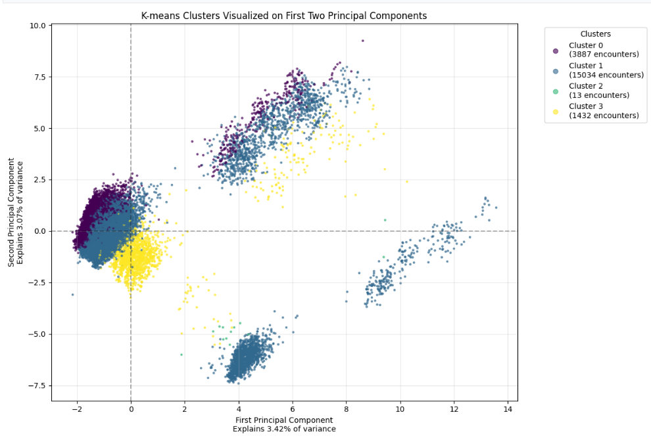
Study Outcome
Original PCA

Slide 8
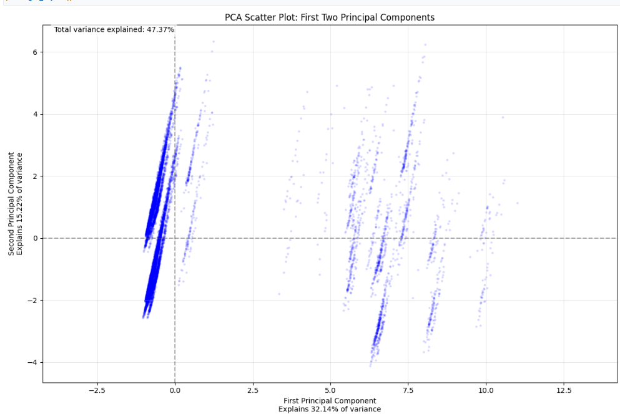
Study Outcome
PCA after more processing

Slide 9
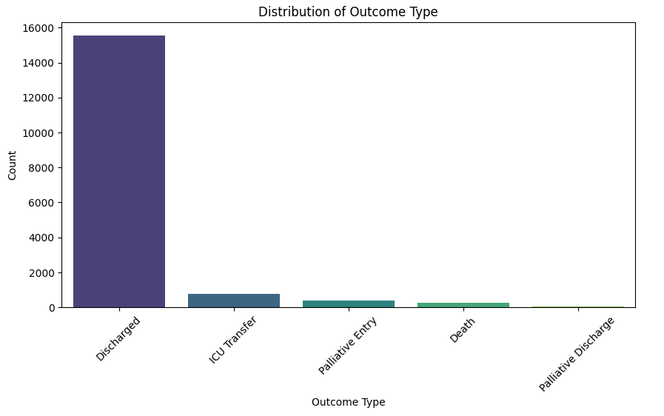
Predicting Outcome Type
ICU Transfer
Death
Palliative Entry
Palliative discharge
Discharge

Slide 10
Next Steps/Challenges
Identify clusters in re-made PCA → target hit features → run regression model
Incorporate other variable data types with robust server
Unbalanced dataset (more discharged patients)
Incorporate comparison between lab-values and baseline

Slide 11
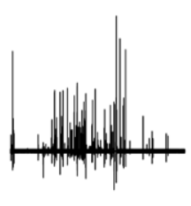
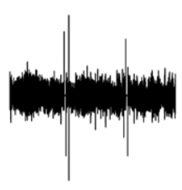
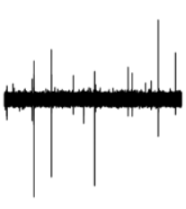
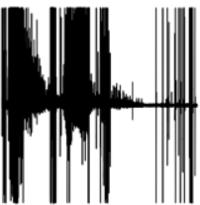
Predict Patient’s Sleep Apnea with CNN Method:
Input: EDG Signal Plot Images

Slide 12
